Slide 1

Acu-AI by Team Eta
Keith Vincent, Evan Templin, Josh Van Hoesen, Yuriy Zaletskyy, Emy Cruz, Rob Wire

Slide 2
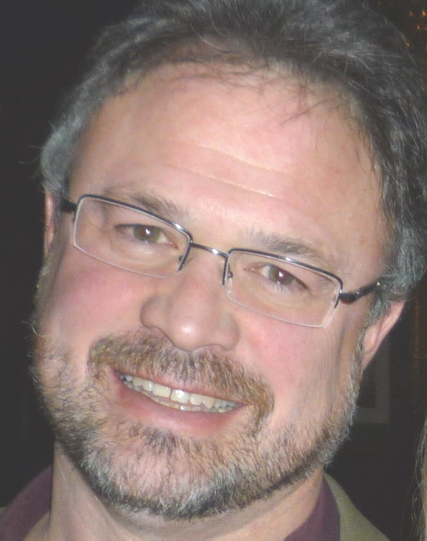
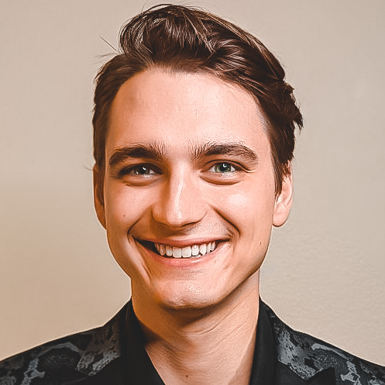


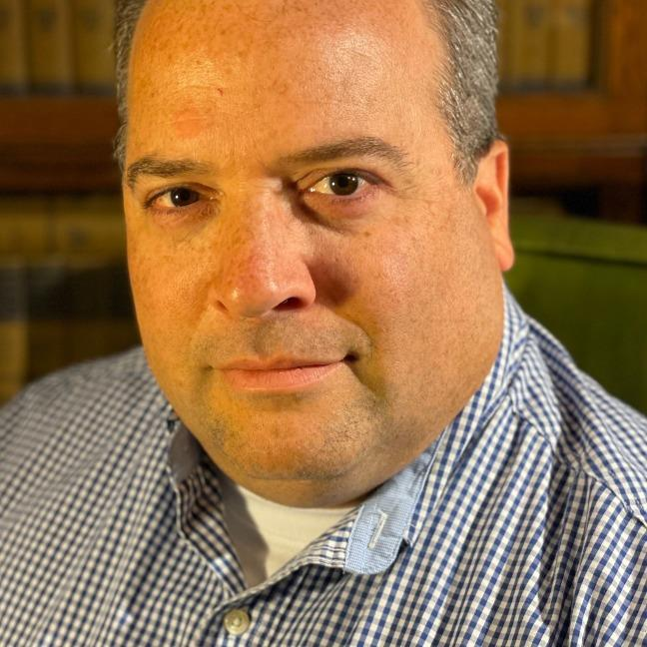
Keith Vincent CEO MFG Stream | Evan Templin Developer Crestwood Associates | Josh Van Hoesen Developer ASI LLC
Yuriy Zaletskyy Developer AcuPower | Emy Cruz Vice President Britec | Rob Wire Sr. VP of IT STS Aviation Group

Slide 3



Slide 4
Acu-AI Customer Service
Focus on Customer Service requests
Automated Email Response
Automated Chat Bot Response
Powered by Acumatica, leveraging OpenAI ChatGPT

Slide 5
Now for our demonstration

Slide 6
Summary Data Points
Acumatica allows for Citizen Developers or Professional Developers to integrate
Freeing up Customer Service Reps time for more productivity
Providing instantaneous response to many customer service questions
Future functionality to evaluate past responses and train ChatGPT on effective answers
Future updates could include SMS Text, Secure email validation, Accounts Payable, Inventory, Operational Inquiries

Slide 7
Keith Vincent | keith@MFGStream.com
Evan Templin | etemplin@crestwood.com
Josh Van Hoesen | jvanhoesen@asillc.com
Yuriy Zaletskyy | yuriy.zaletskyy@acupower.co.uk
Emy Cruz | emy@britec.com
Rob Wire | Rob.wire@stsaviationgroup.com

